Slide 1

Slide 1
NETFLIX STOCK PROFILE
Visualizations of NFLX performance (with DJIA comparison)

Slide 2

INCLUDED VISUALIZATIONS
2017 Netflix Stock Prices by Quarter
2017 Earnings per Share (EPS) by Quarter
2017 Revenue vs. EPS by Quarter
2017 Netflix vs. Dow Jones by Month

Slide 3
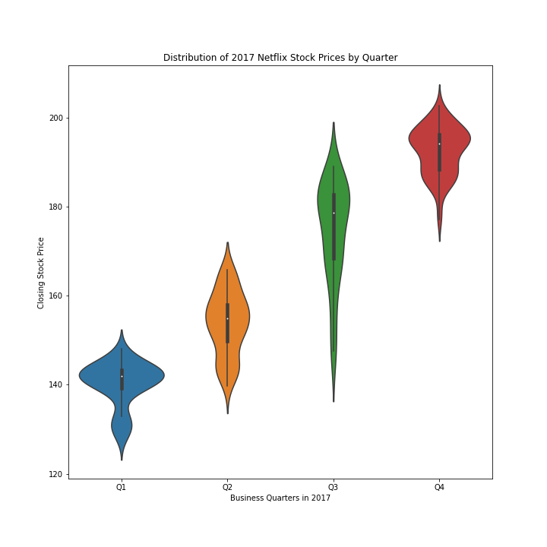
STOCK PRICE BY QUARTER
Median stock price per quarter: RISING
Stock price is skewed on the lower side of price for every quarter. 2017 had the widest range of stock prices.
Range of stock price for 2017: between roughly $140 and $190 USD.
Lowest price: slightly over $120 during Q1
Highest price: slightly over $200 during Q4

Slide 4
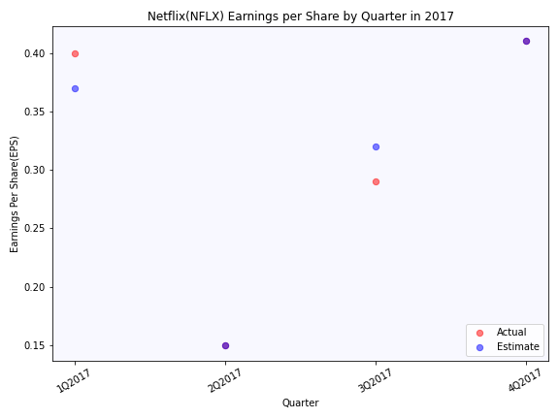
EARNINGS PER SHARE (EPS) BY QUARTER
Actual EPS and Estimate were nearly identical in Q2 and Q4

Slide 5
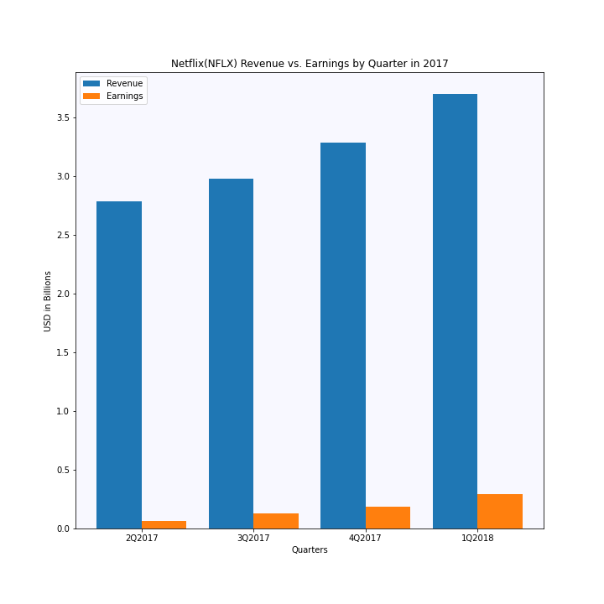
REVENUE VS. EARNINGS
Revenue follows an upward trend, as does Earnings
Average percent of revenue that constitutes earnings is 5%

Slide 6
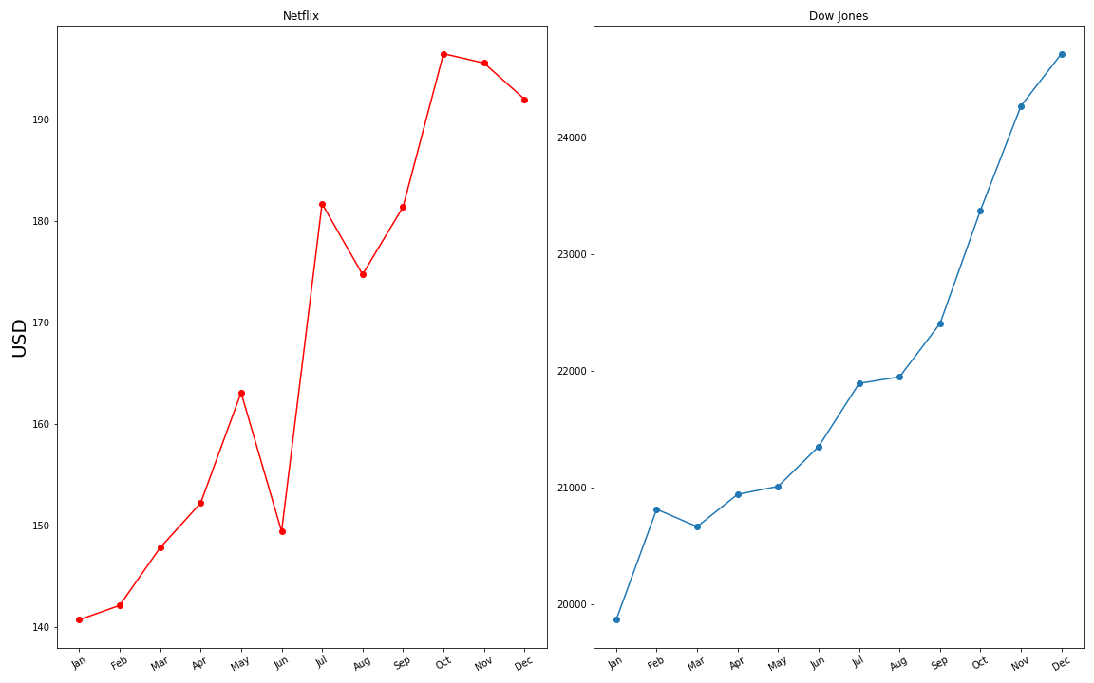
NETFLIX (NFLX) vs DOW (DJIA)
Netflix performed roughly on the same trendline as DOW, aside from May - July
During that time, Netflix was more volatile
Price is incomparable as the DJIA is an industry average and is affected by multiple corporations.

Slide 7

Slide 11
THANK YOU

